Slide 1
Basic Development Flow ZYNQ
2024

Slide 2
Agenda
Introduce
Lab1 – For Loop Acceleration
Lab2 – GPIO Led Control

Slide 3

Introduce
Acceleration Flow
Synthesize a C/C++ function into RTL with the Vitis HLS
Integrate IP with the Vivado Design Suite
Test with the Jupyter Notebook

Slide 4


System Setup
Software
Vivado 2023.1
Vitis HLS 2023.1
Lab source
https://github.com/eefae
Hardware
PYNQ-ZU
https://www.e-elements.com.tw/products/fpga_system/xup_pynq/pynq-z2/
https://github.com/Xilinx/PYNQ-ZU

Slide 5
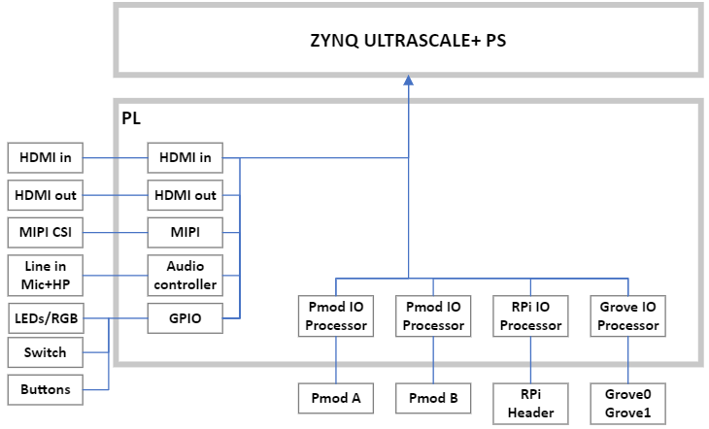
Base Overlay

Slide 6
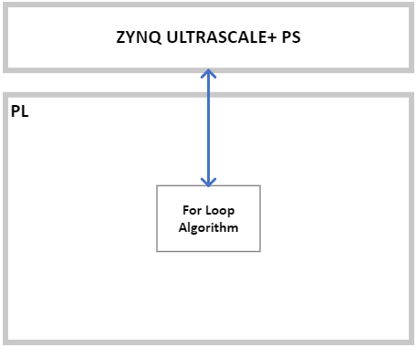
Lab1 – For Loop

Slide 7
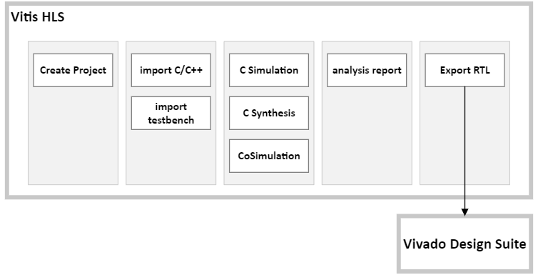
Vitis HLS

Slide 8
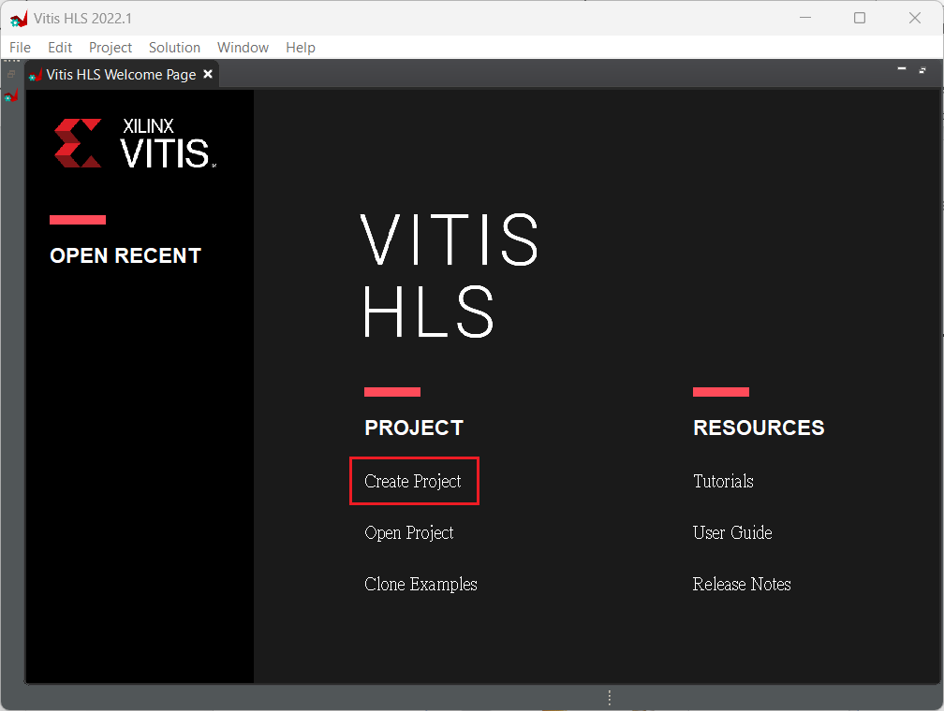
Create Project

Slide 9
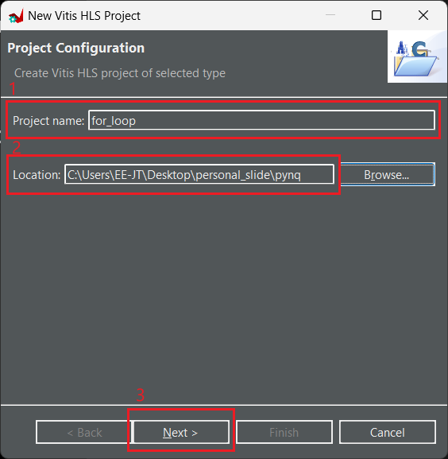
Create Project

Slide 10
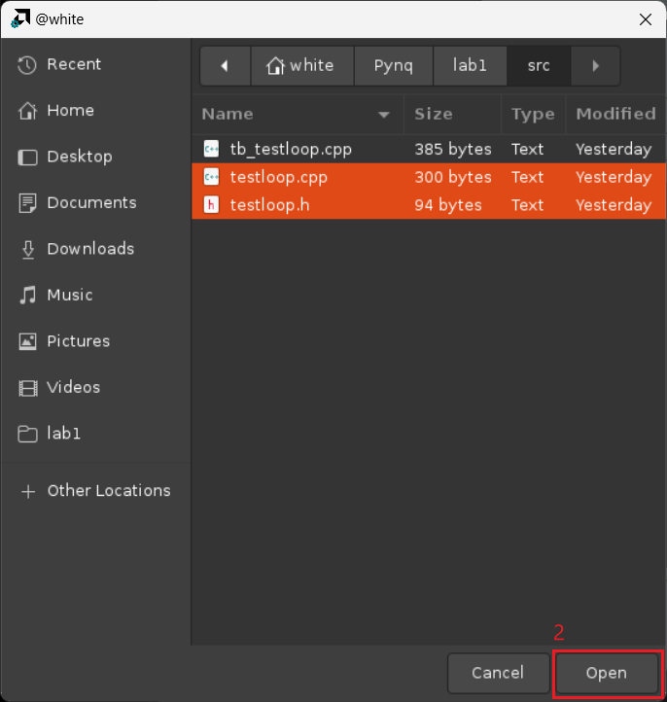
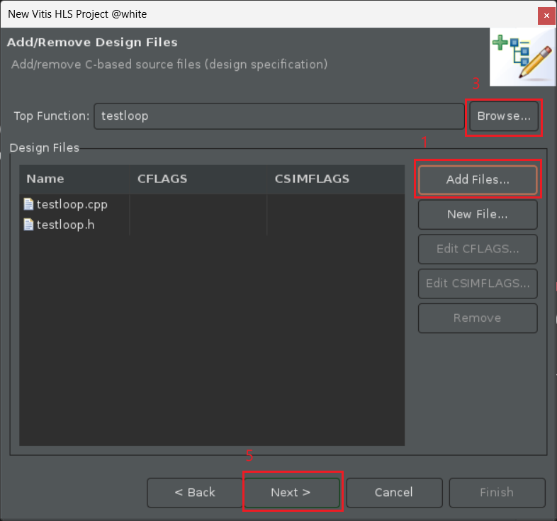
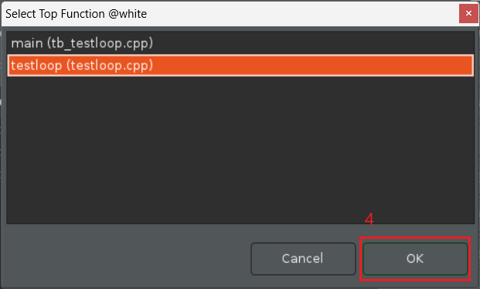
Import Source code

Slide 11
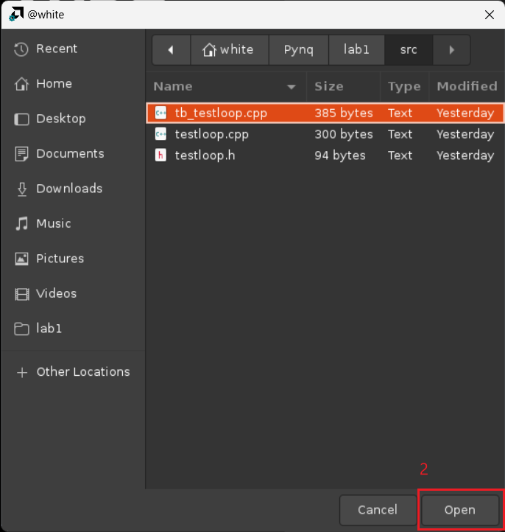
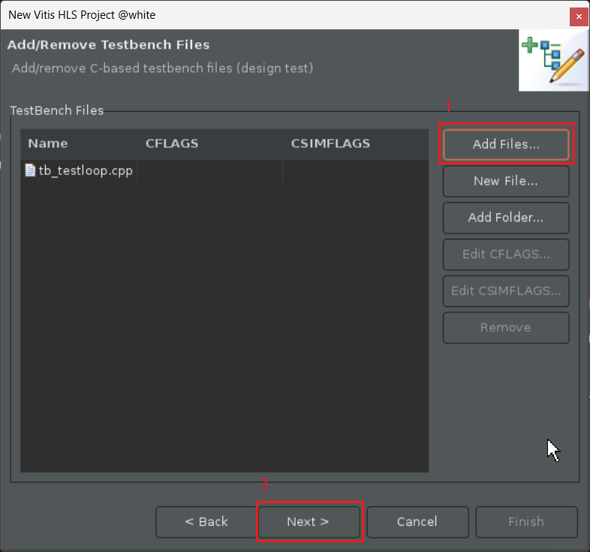
Import Source code

Slide 12
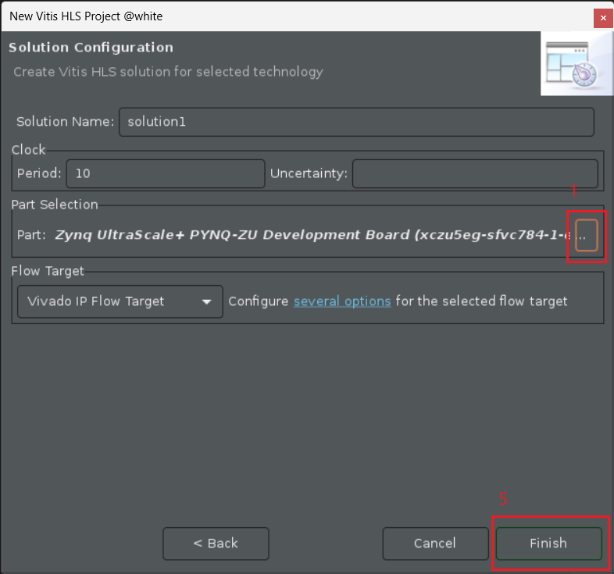
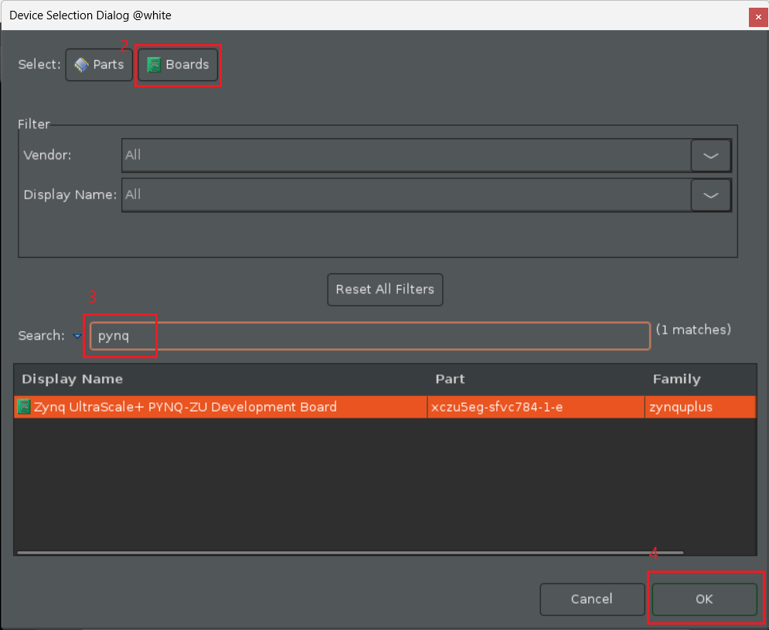
Solution Configuration

Slide 13
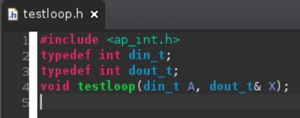
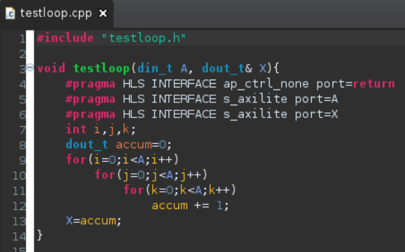
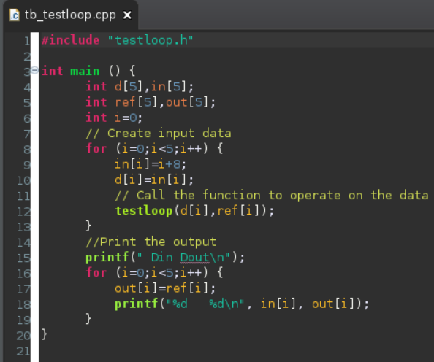
Source Code

Slide 14
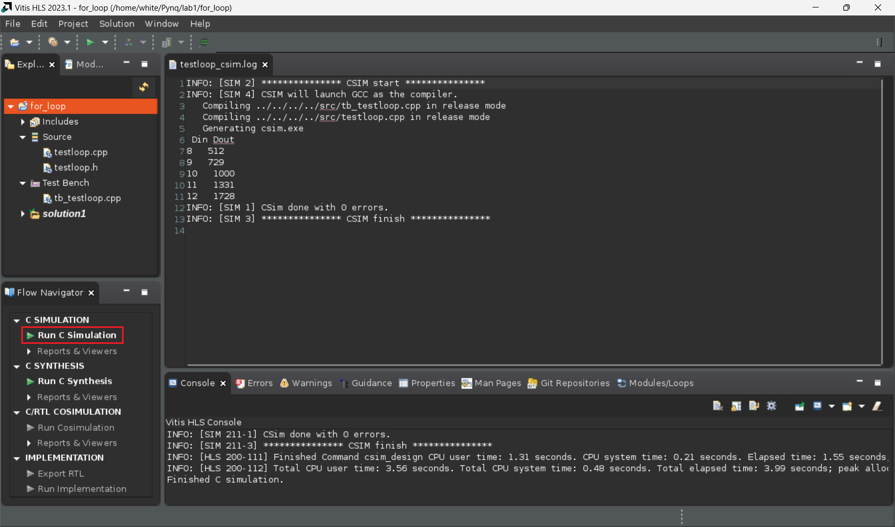
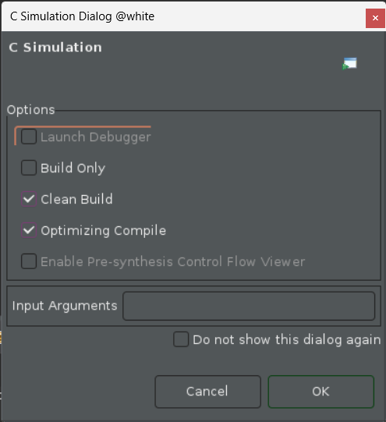
Run C Simulation

Slide 15
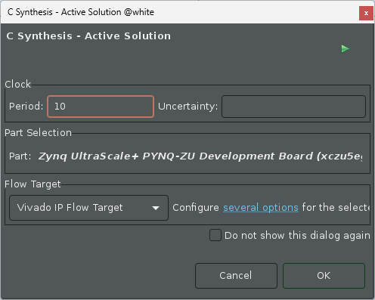
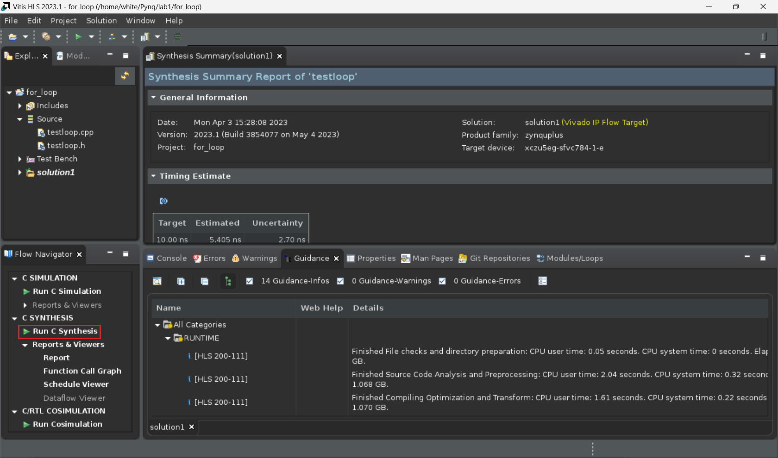
Run C Synthesis

Slide 16
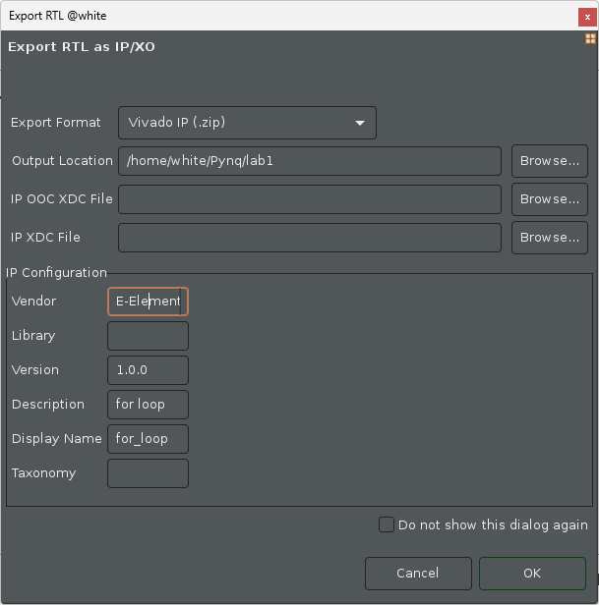
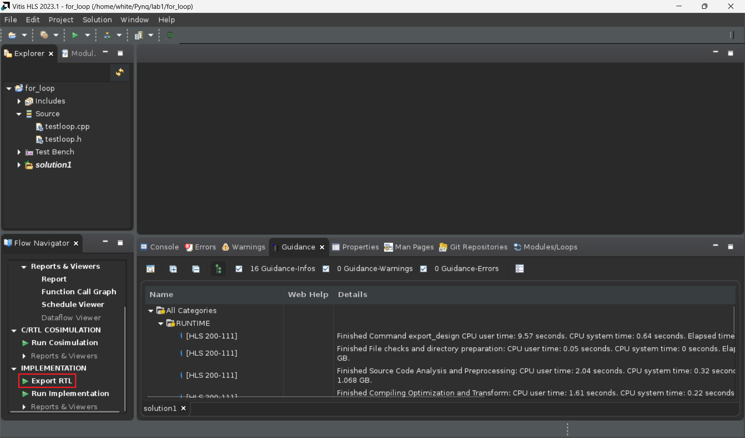
Export RTL

Slide 17
IP Information
Check memory map
the memory map file is in the
/path-to-solution1/impl/ip/drivers/testloop_v1_0/src/xtestloop_hw.h

Slide 18
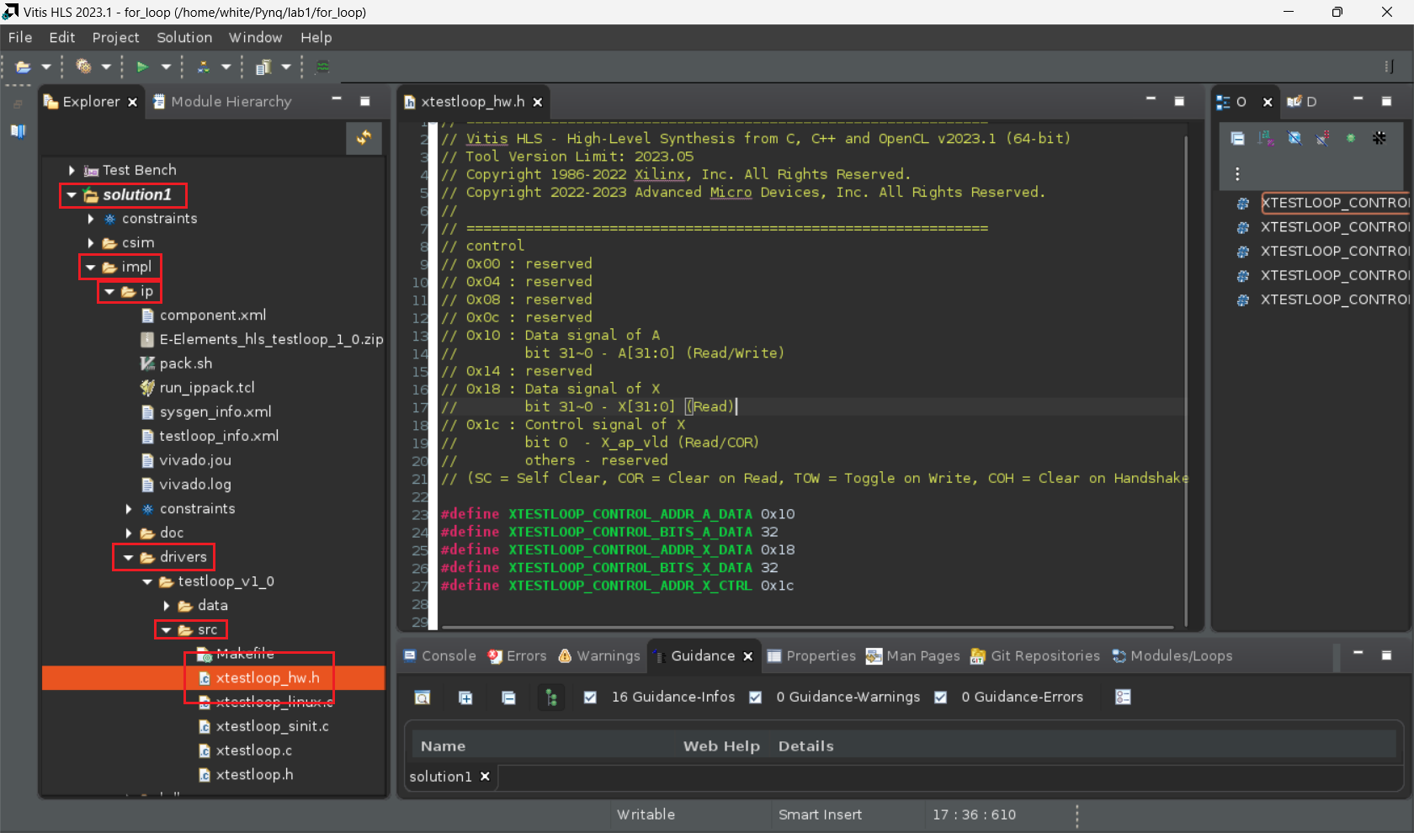
IP Information
Check memory map
the memory map file is in the
/path-to-solution1/impl/ip/drivers/testloop_v1_0/src/xtestloop_hw.h

Slide 19
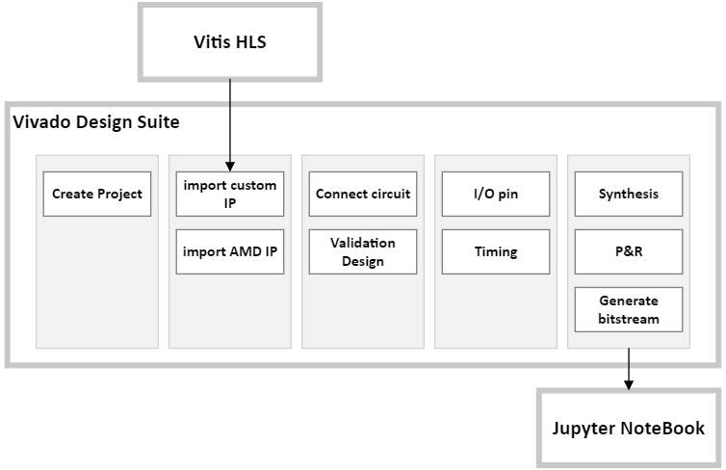
Vivado Design Suite

Slide 20
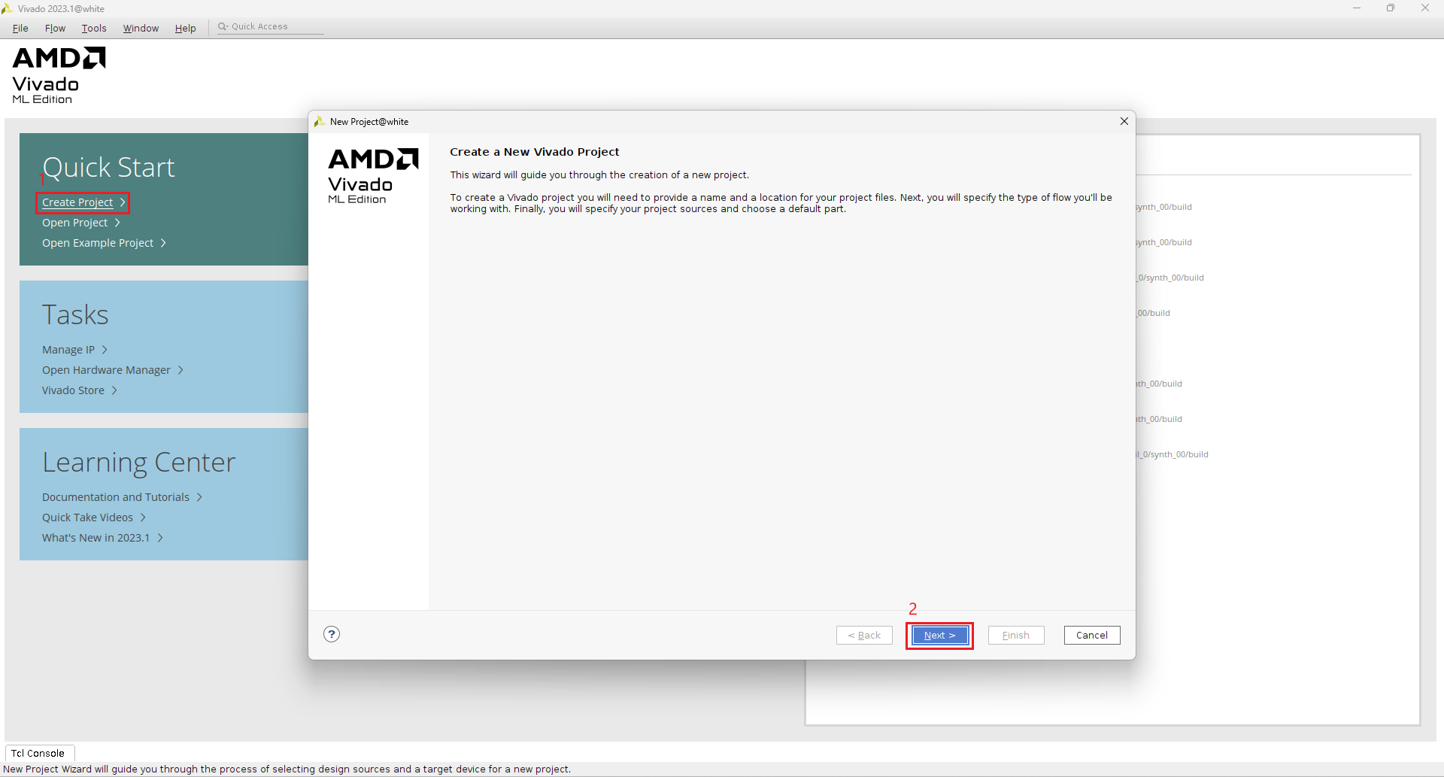
Create Project

Slide 21
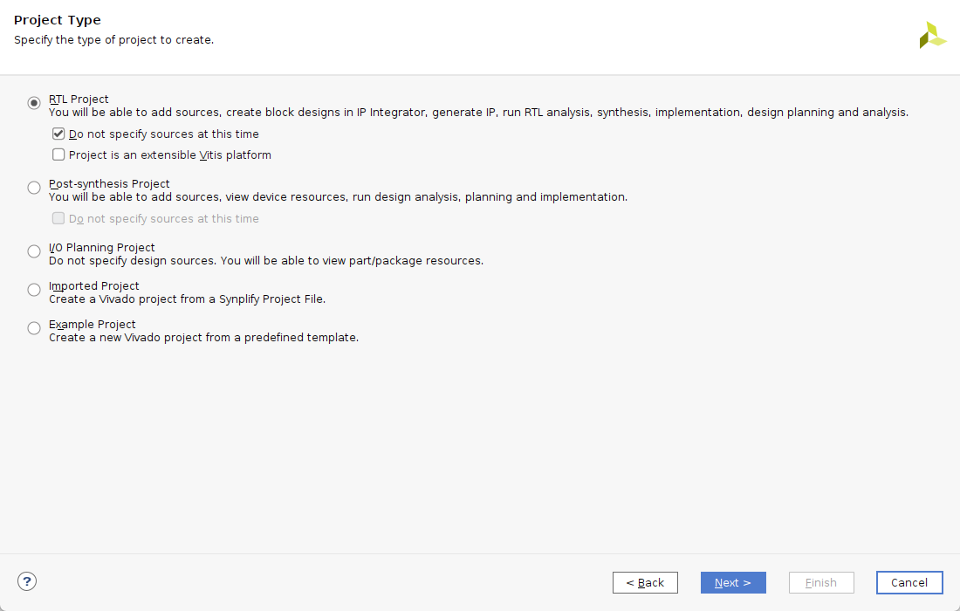
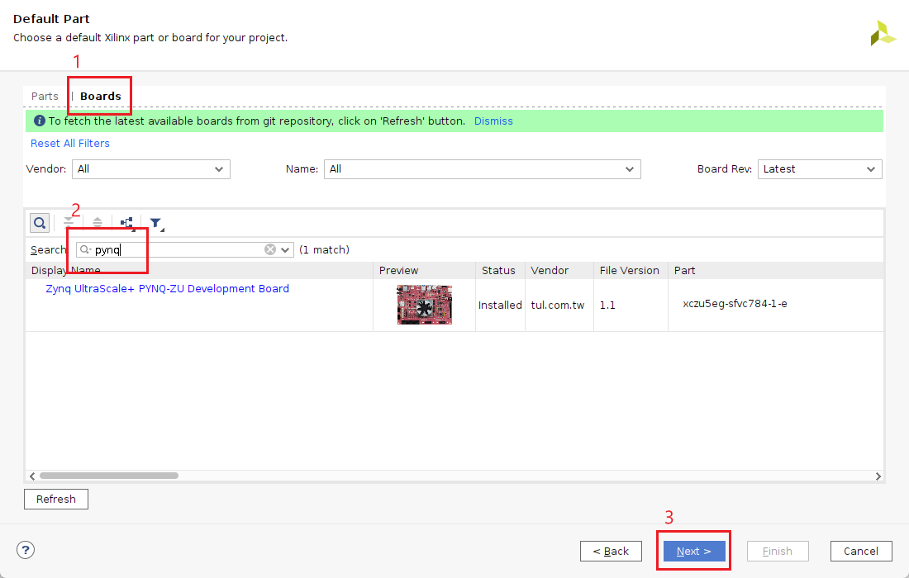
Create Project

Slide 22
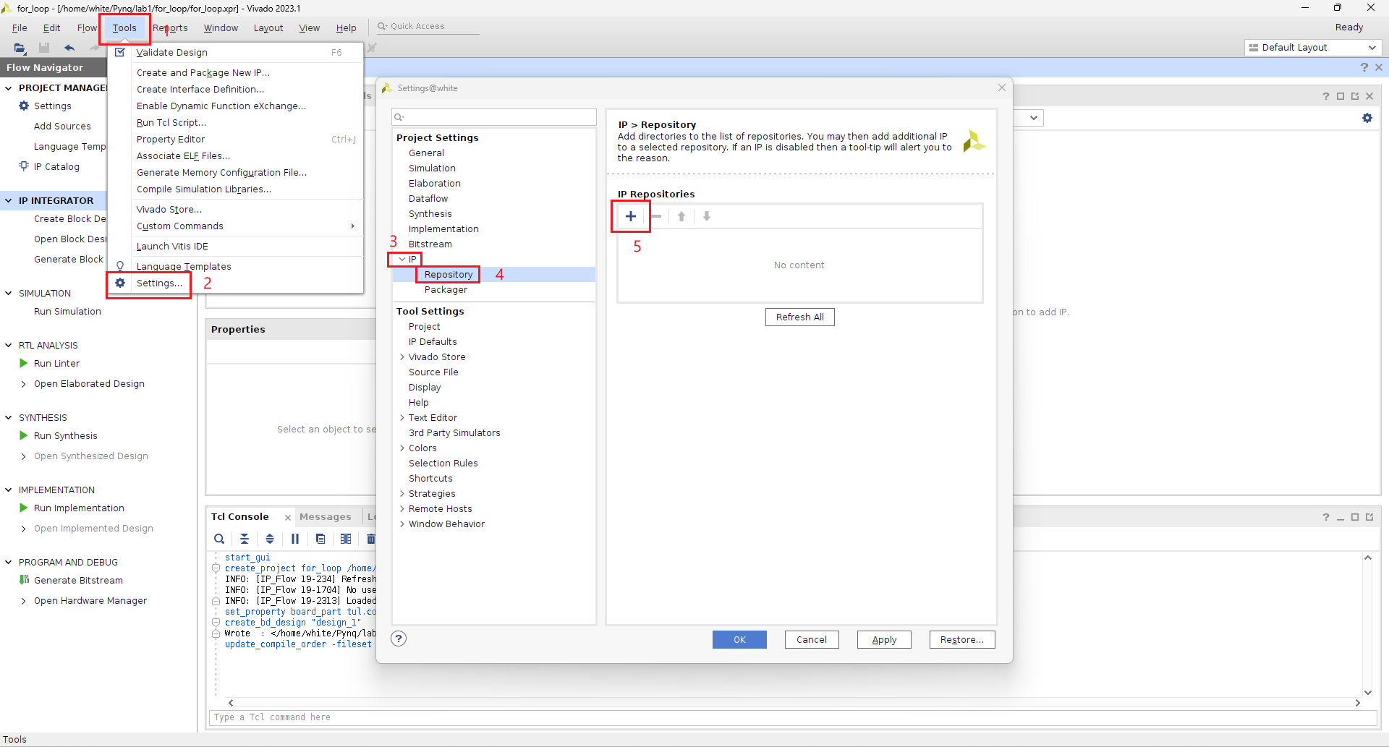
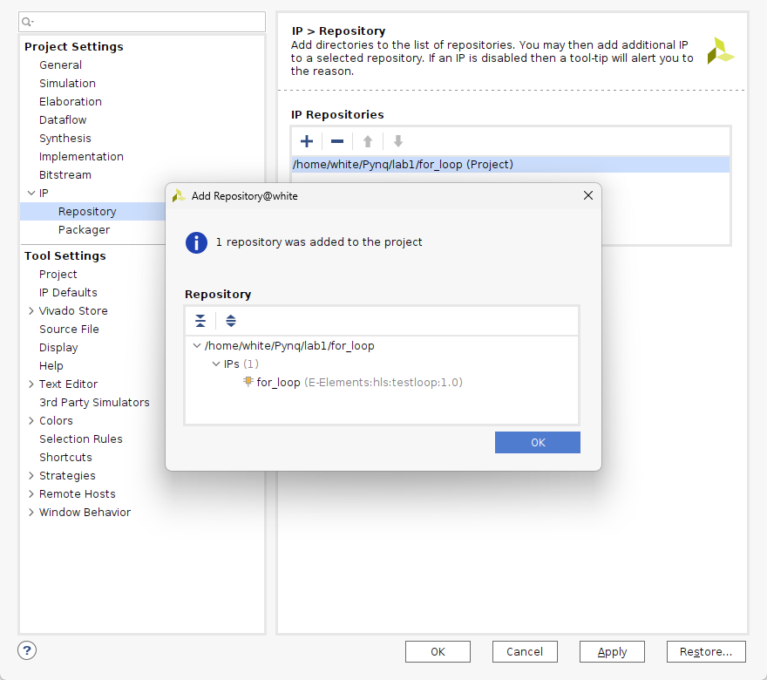
Import Custom IP

Slide 23
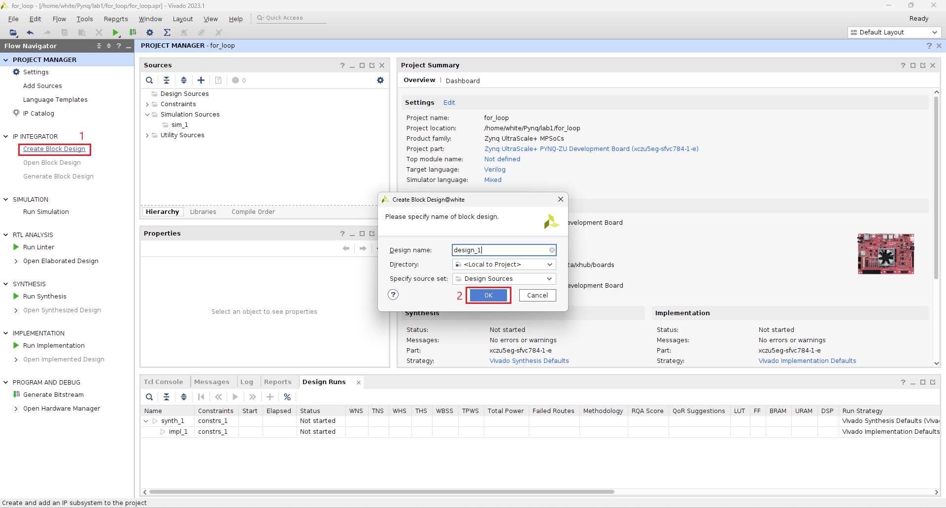
Create Block Design

Slide 24
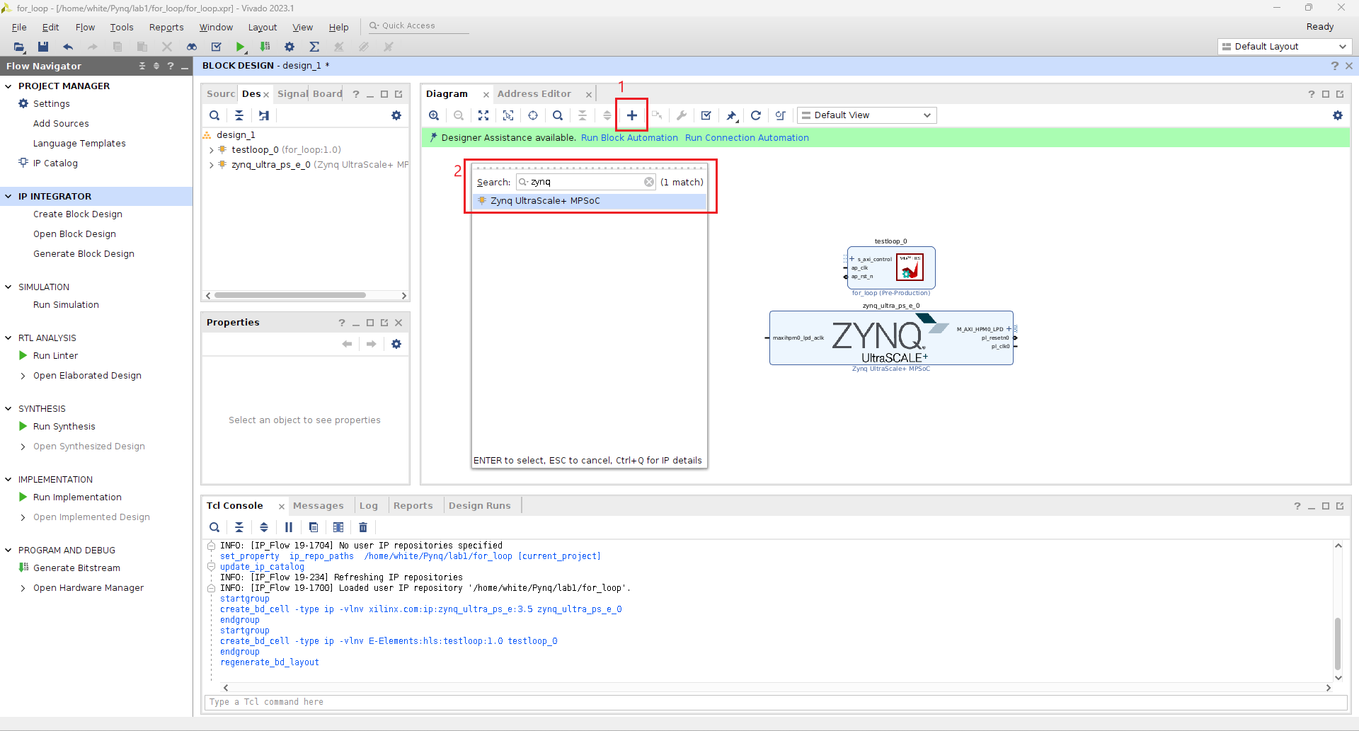
Add IP

Slide 25
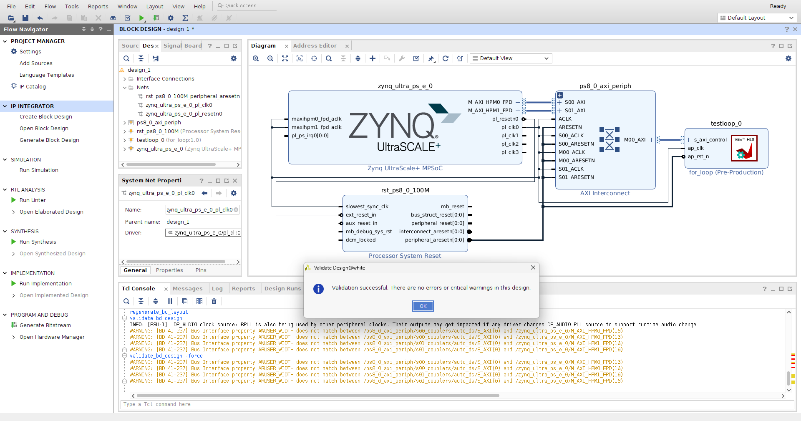
Connect/Validation IP

Slide 26
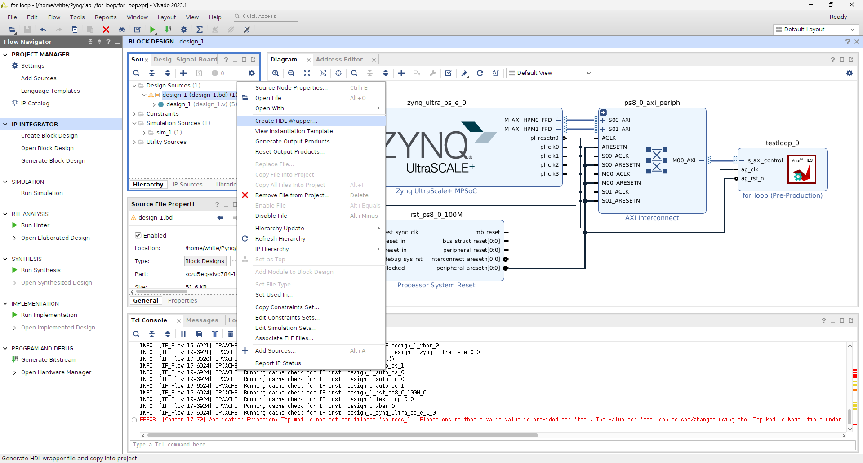
Create HDL Wrapper

Slide 27
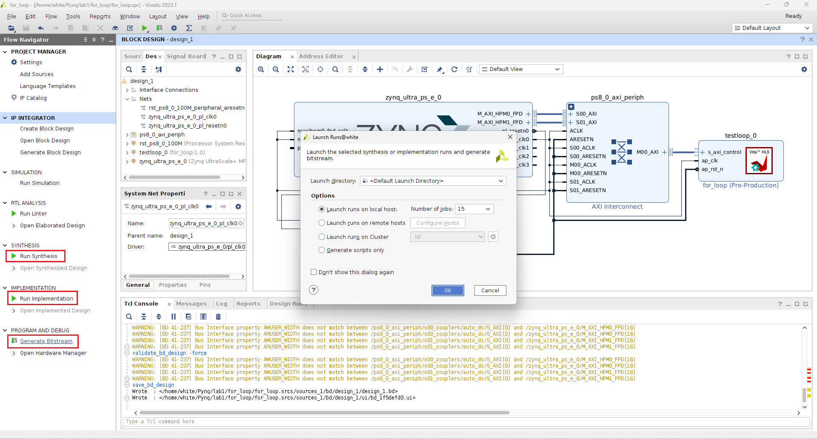
Generate Bitstream

Slide 28
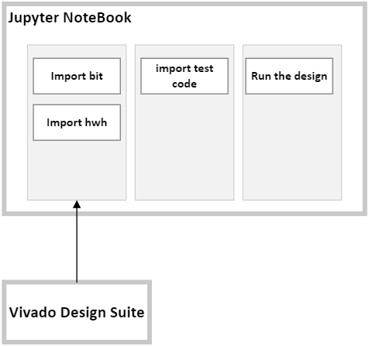
Jupyter NoteBook

Slide 29
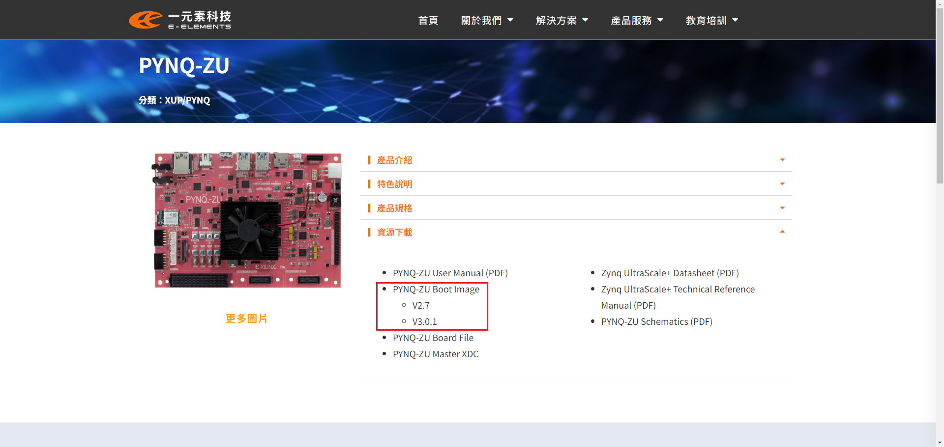
Burn the boot SD card

Slide 30
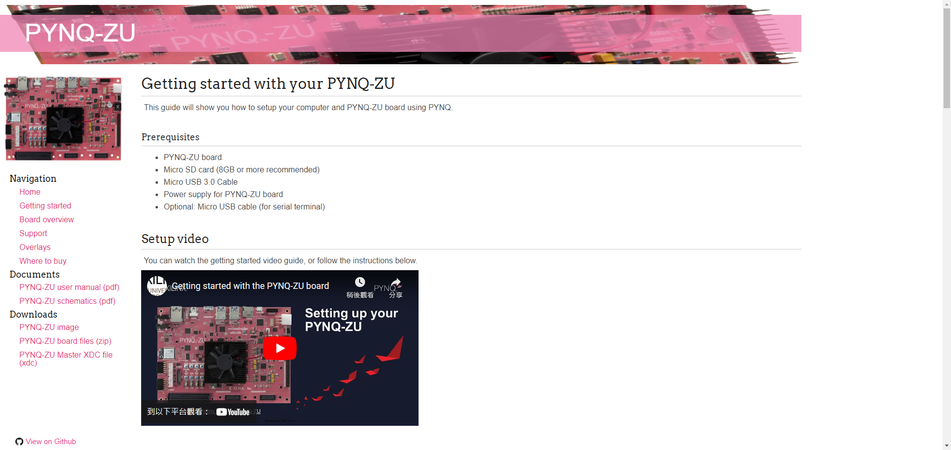
Setup Development Board
https://xilinx.github.io/PYNQ-ZU/getting_started.html

Slide 31
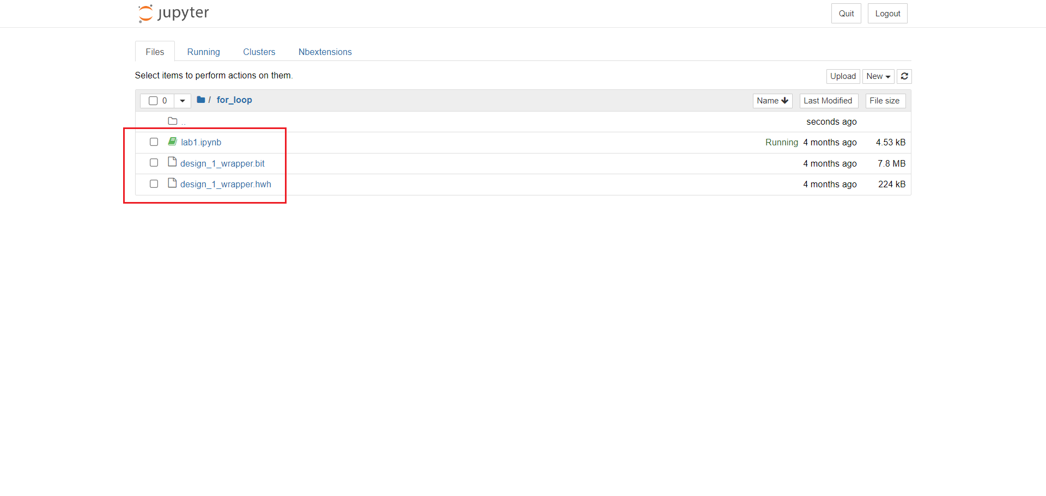
Import hwh, bit, test code

Slide 32
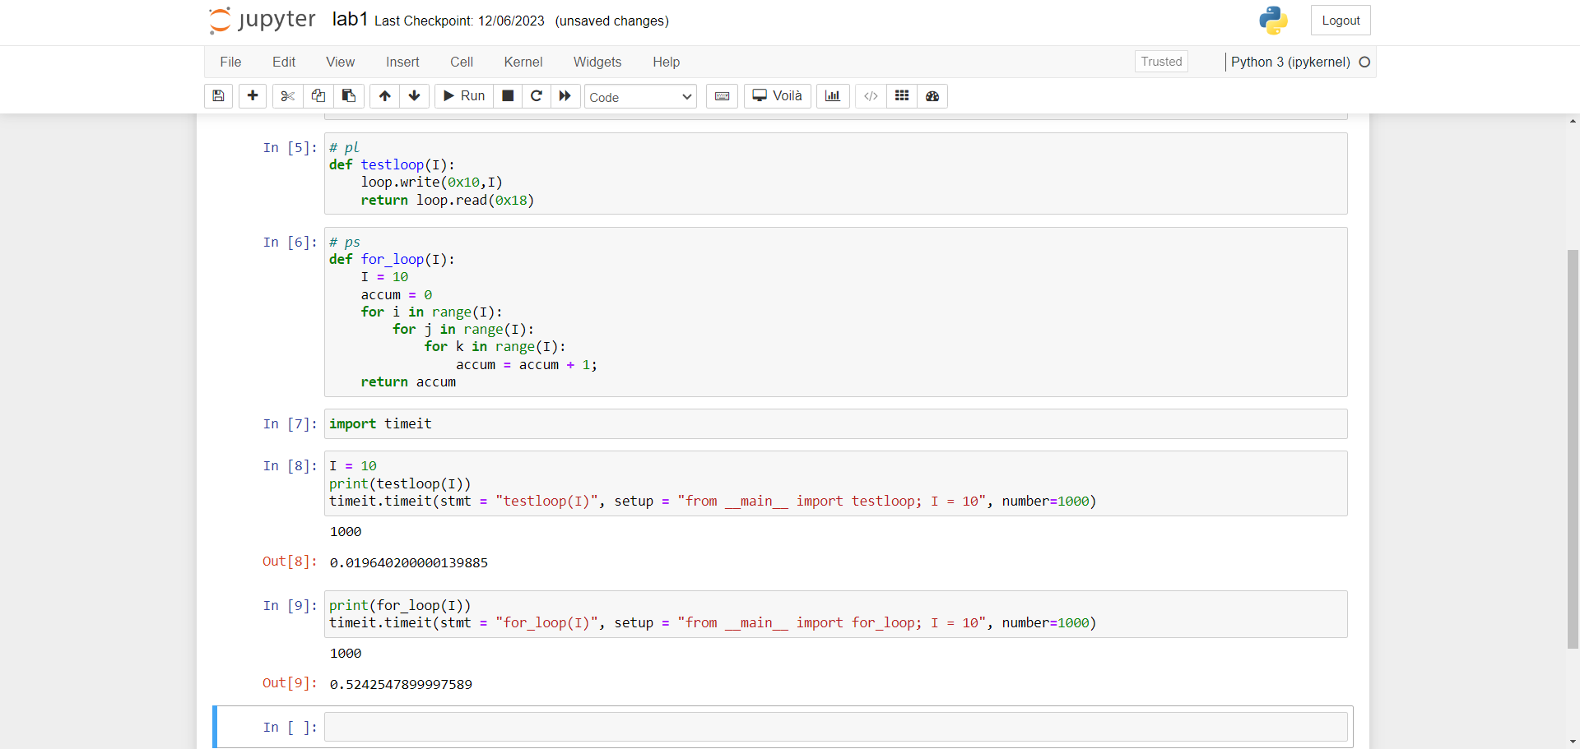
Run the design

Slide 33
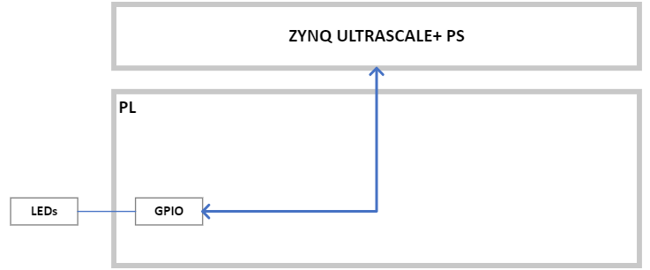
Lab2 – GPIO led control

Slide 34
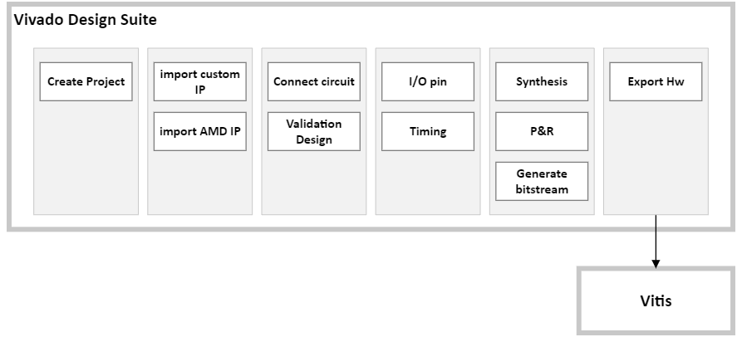
Vivado Design Suite

Slide 35
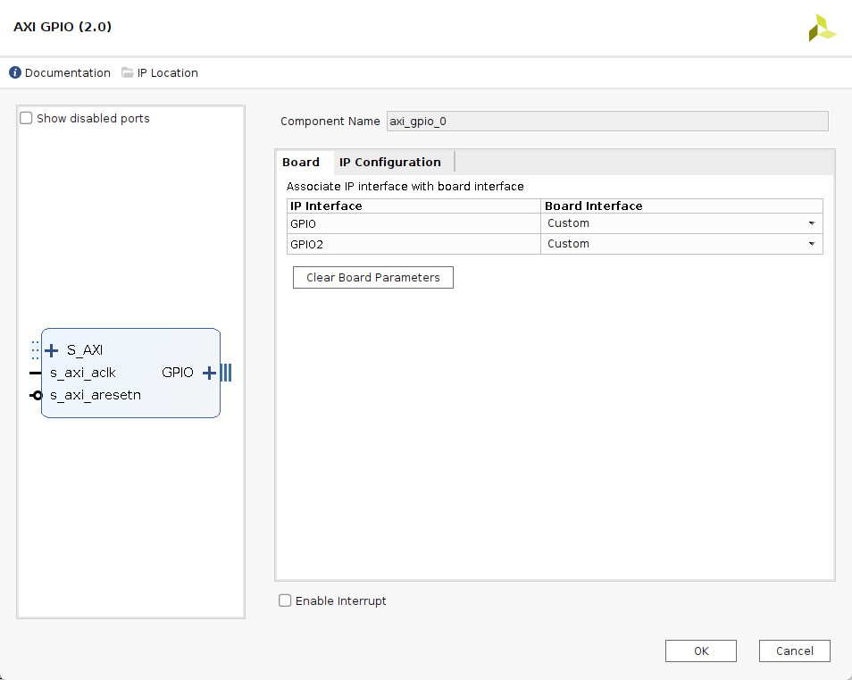
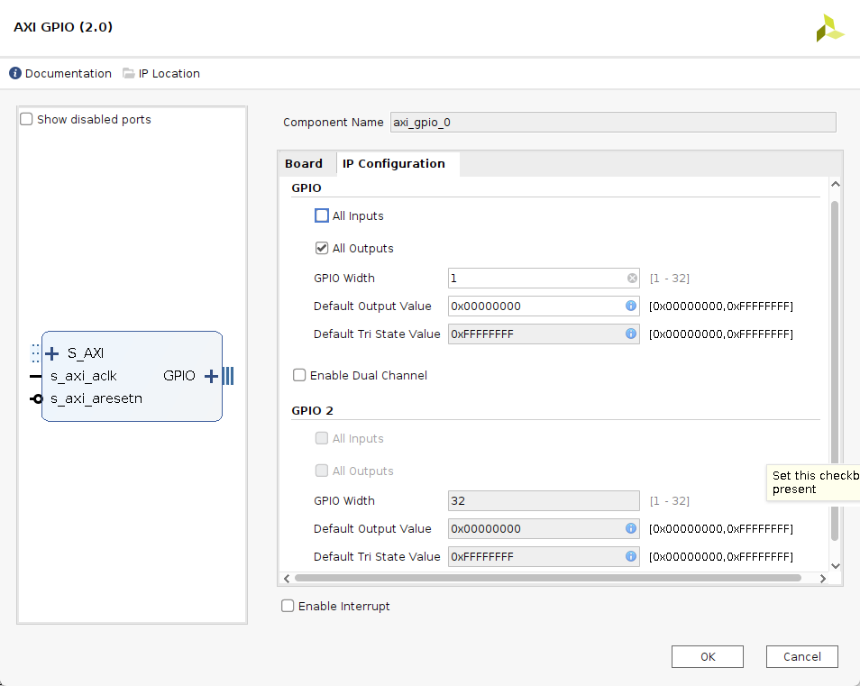
AXI GPIO (2.0)

Slide 36
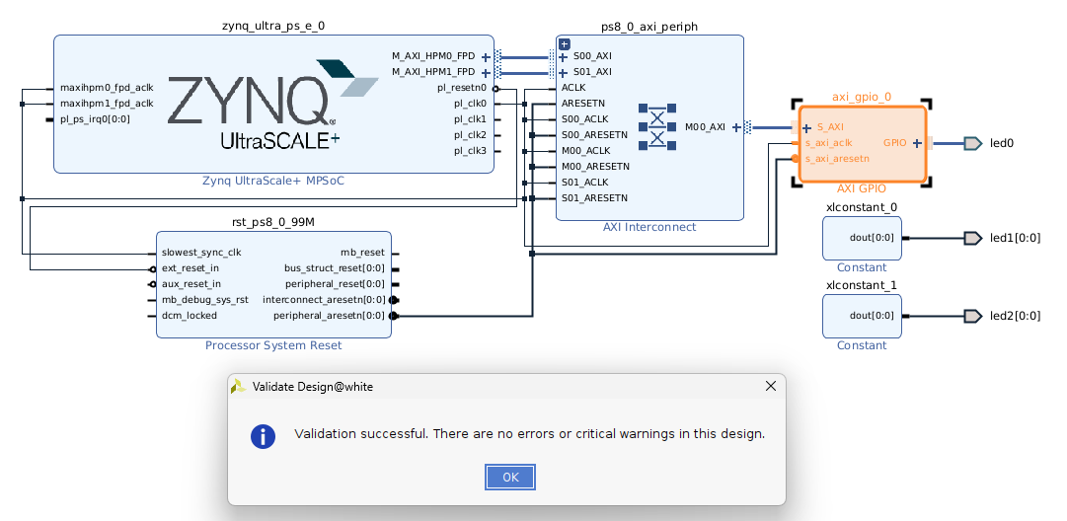
Connect/Validation IP

Slide 37
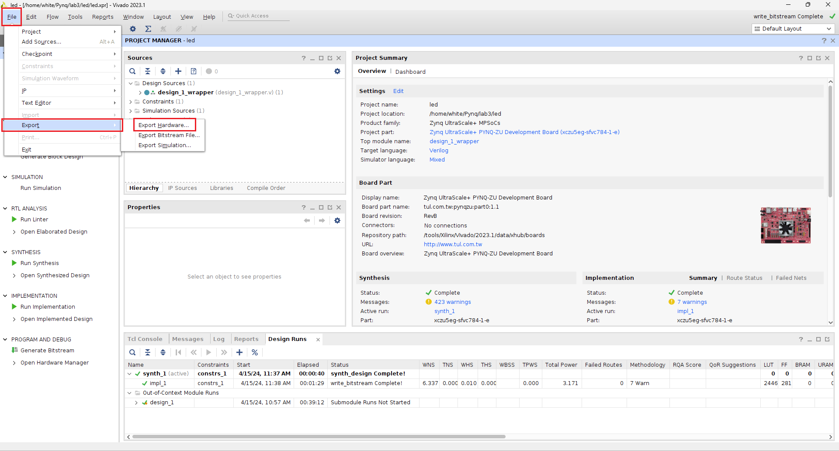
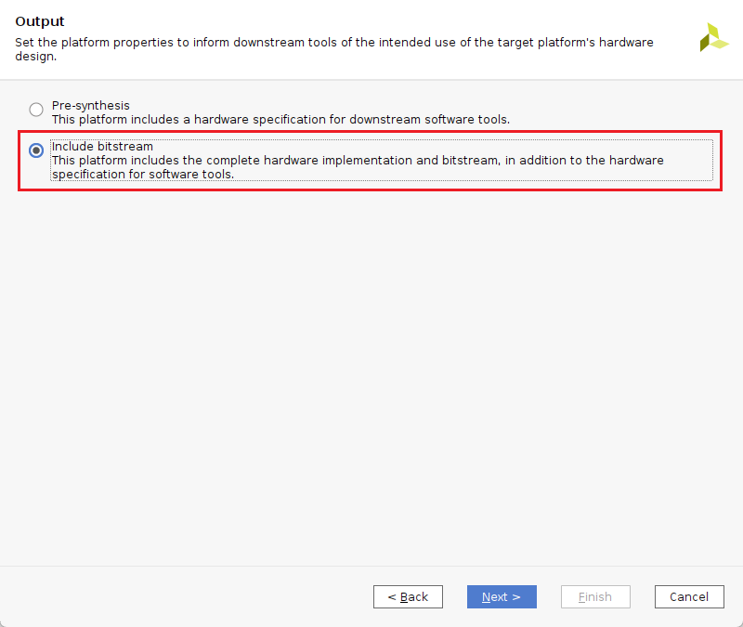
Export Hardware

Slide 38
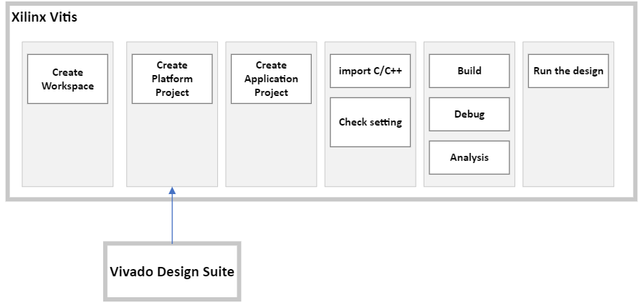
Xilinx Vitis

Slide 39
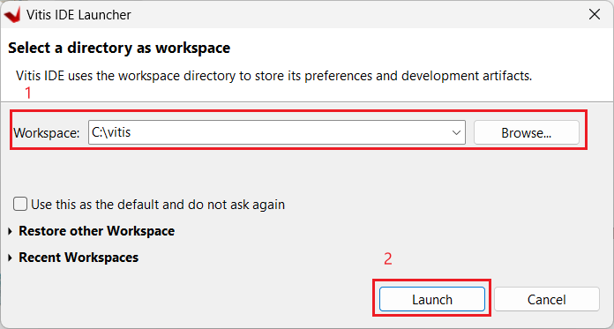
Create Workspace

Slide 40
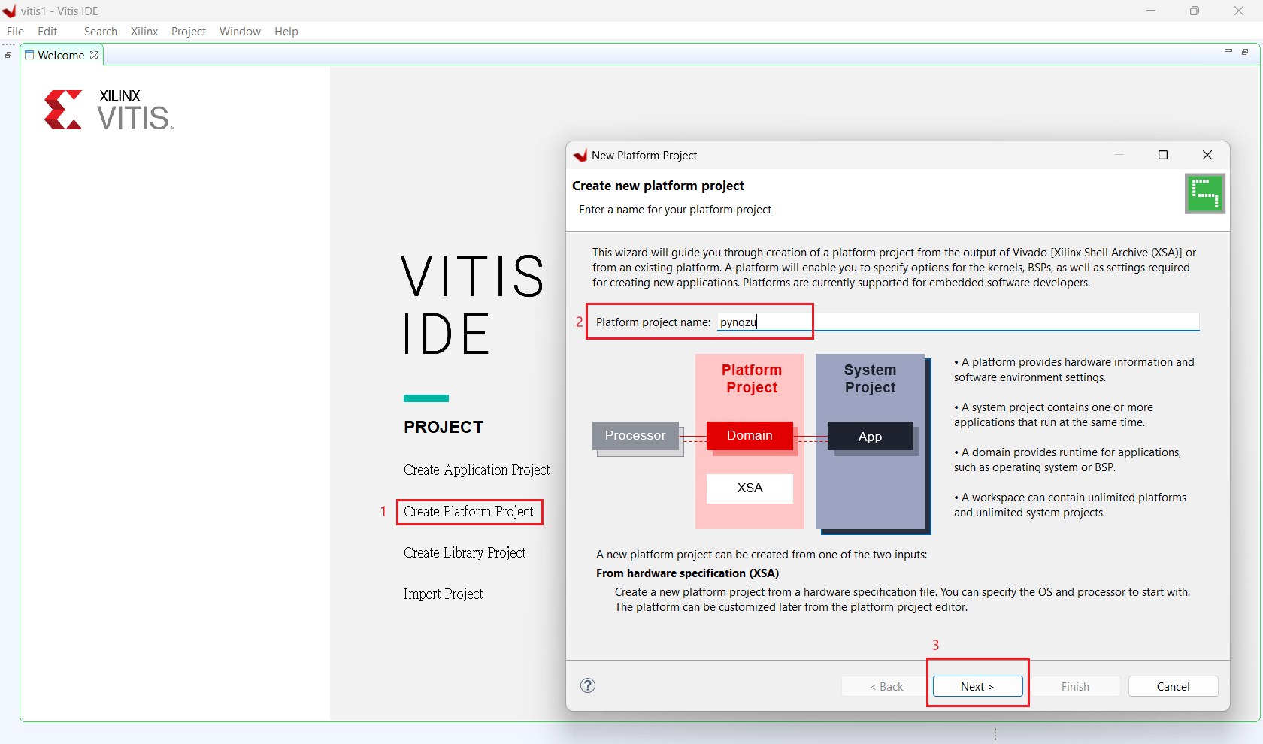
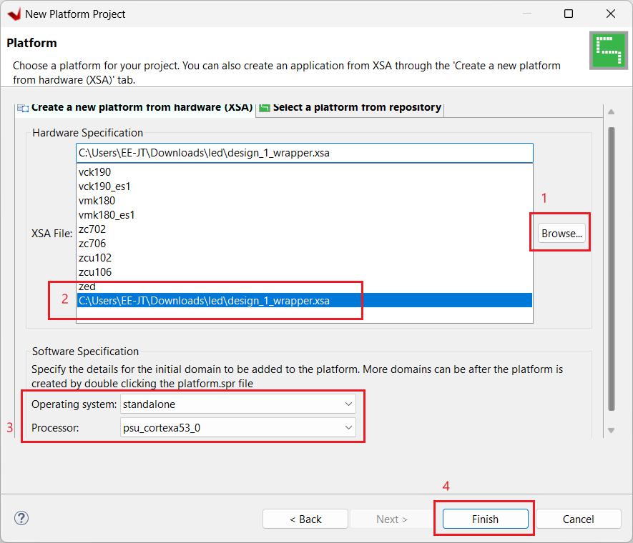
Create Platform Project

Slide 41
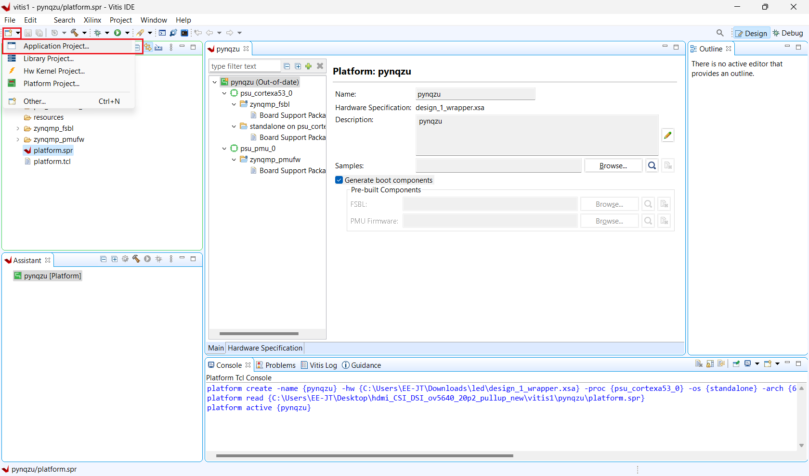
Create Application Project

Slide 42





Create Application Project

Slide 43

Build All Project

Slide 44

Run the Demo

Slide 45

聯絡我們
一元素科技
sales@e-elements.com
e-elements.com
Contact Us

